Slide 1
ECD Care Center Meeting
Erdheim-Chester Disease Global Alliance
April 2023
Mayo Clinic
Rochester, Minnesota
Kathy Brewer – Founder/President ECDGA
Paul Hendrie, MD, PhD – Fred Hutchinson Cancer Center & ECDGA Board Member
Notes:
These slides can hopefully be used in the Medical Symposium and the PFG. Could add/subtract modify for each, but this would be the basic info to present.

Slide 2
ECDGA 2-Year Goals
Dramatically increase the number of persons with ECD to receive an early diagnosis
Support relevant research to improve the quality of life for people with ECD and their loved ones
1 Early Career Grant of $50K in 2023
Possible Additional $100K Patient-Centered Grant in 2023
Build an even stronger global community of informed and connected patients, caregivers and physicians
Develop long-term sustainability plans for the ECDGA
Notes:
Not sure where this will be presented

Slide 3
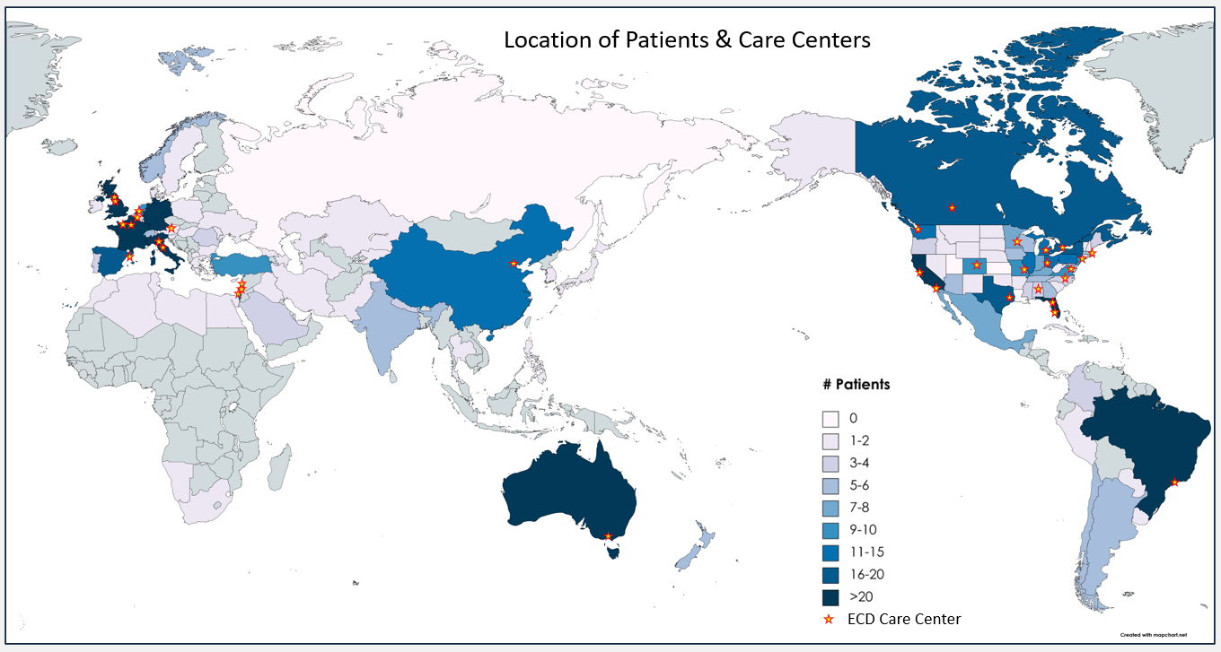
ECD Care Centers & Patients
Care Centers
Peter MacCallum Cancer Center
Elisabethinen Hospital
Universite Libre de Bruxelles; Hopital Erasme
Hospital das Clinicas – Instituto do Cancer do Estado de Sao Paulo
University of Alberta
Mount Sinai Hospital
Peking Union Medical College Hospital
Hospitalier Pitié-Salpêtrière
CHU CAEN – UNIVERSITE BASSE- NORMANDIE
Assuta Medical Center
Shaare-Zedek Medical Center
IRCCS San Raffaele Scientific Institute
AOU Meyer
American University of Beirut Medical Center
Erasmus University Medical Center
Hospital Universitari de Bellvitge
University of Leeds
Newcastle University
University of Alabama at Birmingham
Stanford University
UC San Diego Moores Cancer Center
University of Colorado School of Medicine
Moffitt Cancer Center
University of Florida Health
Johns Hopkins
Dana-Farber Cancer Institute
University of Michigan
Mayo Clinic
Washington University in St. Louis
Memorial Sloan-Kettering Cancer Center
Duke Cancer Institute
University of Cincinnati
Baylor College of Medicine, Texas Children's Cancer Center
Fred Hutchinson Cancer Center
Notes:
Care Centers we have lost
MD Anderson
Vanderbilt
Columbia
Orlando
Gained
Moffitt
University of Florida
University of Michigan
Erasmus University, Rotterdam, Netherlands
Hospital Univ de Bellvitge, Barcelona, Spain

Slide 4
Care Center Survey Results – Treatments & Registry
59% of 34 Centers Responding
744 Patients Seen
<2% Patients Passed in Last 12 Months
110 New Patients Seen in Last 12 Months
69% of Patients on Targeted Treatment
31% of Patients on BRAF Inhibitor
30% of Patients on MEK Inhibitor
5% of Patients on Combo Inhibitor
10% of Patients on Interferon Treatment
7% of Patients on Other Treatment
13% of Patients Known in Registry
Notes:
Responding: (19 of 34)
Elisabethinen; Linz, Austria
Univ of Alberta
Mount Sinai, Toronto
Assuta, Tel Aviv Israel
AOU Meyer, Florence
Erasmus University, Rotterdam, Netherlands
Hospital Univ de Bellvitge, Barcelona, Spain
UAB, Birminham, Alabama
UC San Diego, San Diego, California
Univ of Colorado, Denver, Colorado
Moffitt, Tampa, Florida
Univ of Florida, Gainesville, Florida
Johns Hopkins, Baltimore, MD
Univ of Michigan, Ann Arbor, MI
Mayo, Rochester, MN
MSK, New York, NY
Duke, Durham, NC Baylor, Houston, TX, Paris

Slide 5
Care Center Survey Results – What Can the ECDGA Do?
With 20 of 34 Care Centers Responding:
Advocate for/ Help with Treatment Access (2)
Guide Patients to Care Centers (3)
Share Information About Studies (1)
Provide Patient Support for Travel to Care Centers (1)
Focus on Earlier Diagnosis (1)
Educate and Share Info (3)
Create/Support Virtual Tumor Board (1)
Access to Registry (1)
Wants to be Involved in Clinical Trials (1)
More Research Funds (1)
Notes:
Responding: (19 of 34)
Elisabethinen; Linz, Austria
Univ of Alberta
Mount Sinai, Toronto
Assuta, Tel Aviv Israel
AOU Meyer, Florence
Erasmus University, Rotterdam, Netherlands
Hospital Univ de Bellvitge, Barcelona, Spain
UAB, Birmingham, Alabama
UC San Diego, San Diego, California
Univ of Colorado, Denver, Colorado
Moffitt, Tampa, Florida
Univ of Florida, Gainesville, Florida
Johns Hopkins, Baltimore, MD
Univ of Michigan, Ann Arbor, MI
Mayo, Rochester, MN
MSK, New York, NY
Duke, Durham, NC Baylor, Houston, TX

Slide 6
Centers Able to Prescribe BRAF & MEK Inhibitors
With 19 of 34 Care Centers Responding:
Able to prescribe BRAF & MEK Inhibitors: 17 (number of institutions can prescribe from only one brand, not both)
Able to prescribe BRAF & MEK Inhibitors after compassionate use: 1
Able to prescribe BRAF Inhibitors Only: 1
Unable to prescribe interferon: 1
Notes:
Responding: (19 of 34)
Elisabethinen; Linz, Austria
Univ of Alberta
Mount Sinai, Toronto
Assuta, Tel Aviv Israel
AOU Meyer, Florence
Erasmus University, Rotterdam, Netherlands
Hospital Univ de Bellvitge, Barcelona, Spain
UAB, Birmingham, Alabama
UC San Diego, San Diego, California
Univ of Colorado, Denver, Colorado
Moffitt, Tampa, Florida
Univ of Florida, Gainesville, Florida
Johns Hopkins, Baltimore, MD
Univ of Michigan, Ann Arbor, MI
Mayo, Rochester, MN
MSK, New York, NY
Duke, Durham, NC Baylor, Houston, TX
Paris – Julien
Jan van Laar – Netherlands reports the targeted treatment is available after compassionate use

Slide 7
ECDGA is Here to Help You & Your Patients
ECDGA is Here to Help You
Trials/Study Recruitment
Education of Patients/Families
Research Funding
ECDGA is Here to Help Your Patients/Families
Education of Patients/Families
Access to Care Centers/ Knowledgeable Doctors
Help with Treatment Access
Community Connections
Volunteer Opportunities to Feel Empowered
Notes:
Responding: (19 of 34)
Elisabethinen; Linz, Austria
Univ of Alberta
Mount Sinai, Toronto
Assuta, Tel Aviv Israel
AOU Meyer, Florence
Erasmus University, Rotterdam, Netherlands
Hospital Univ de Bellvitge, Barcelona, Spain
UAB, Birmingham, Alabama
UC San Diego, San Diego, California
Univ of Colorado, Denver, Colorado
Moffitt, Tampa, Florida
Univ of Florida, Gainesville, Florida
Johns Hopkins, Baltimore, MD
Univ of Michigan, Ann Arbor, MI
Mayo, Rochester, MN
MSK, New York, NY
Duke, Durham, NC Baylor, Houston, TX

Slide 8
2023 ECDGA $200K Grant Awards Congratulations!
$200,000 Patient-Centered Grant Awardees
Gaurav Goyal, MD
University of Alabama at Birmingham
Study Title: Survivorship and Symptom Burden in ECD (UAB)
Matthew Collin, MD, PhD
Newcastle University
Study Title: Tracing the Origins of ECD
$50,000 Early Career Investigator Awardee
Egle Kvedaraite, PhD Karolinska Institutet Study Title: Targeting Disease-Causing Cells in ECD
$20,000 ECDGA/Uplifting Athletes Young Investigator Awardee
Jithma Abeykoon, MD Mayo Clinic Study Title: Prognostic and Therapeutic Significance of Chromosome Region Maintenance 1 (CRM1) Protein in Erdheim Chester Disease
Notes:
Not sure where this will be presented

Slide 9
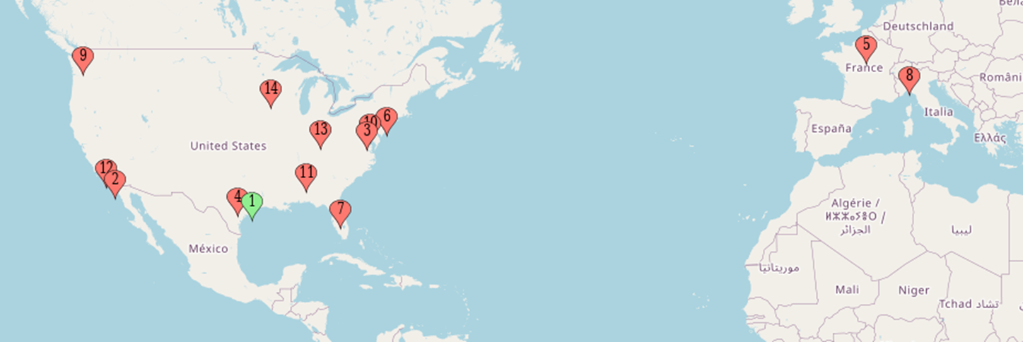
Past Annual & Regional ECDGA Event Locations
Interested in Hosting the 2024 Event?
Host Agreement
• Support funding
• Onsite support personnel
• Event coordinator - logistics of the event
• Patient advocate - provide the patient voice of the local community
• Medical professional – coordinate the agenda/speakers
Notes:
Houston, TX 2012 – Medical/Board Meeting only
San Diego, CA 2013 – 1st Annual Medical/Patient Meeting
Bethesda, MD 2014– 2nd Annual Medical/Patient Meeting
Houston, TX 2015– 3rd Annual Medical/Patient Meeting
Paris, France 2016– 4th Annual Medical/Patient Meeting
New York, NY 2017– 5th Annual Medical/Patient Meeting
Orland, FL 2018– 6th Annual Medical/Patient Meeting
Milan, Italy 2019– 7th Annual Medical/Patient Meeting
Seattle, WA 2021 – Regional Patient Meeting
Bethesda, MD 2021 – Regional Patient Meeting
Virtual 2021 – Medical Meeting only
Birmingham, AL 2022 – Regional Patient Meeting
San Diego, CA 2022 – Regional Patient Meeting
Cincinnati, OH 2022 – Regional Patient Meeting
Rochester, MN 2023 – 8th Annual Medical/Patient Meeting
Host Agreement
• Obtain funding to help support the cost of the meeting (ideally we would like to obtain at least 50% of the cost from sponsors in the host country)
• Appoint onsite support personnel as follows who are able and available to collaborate with ECDGA staff members for a successful event:
• Event coordinator to help manage the logistics of the event (venue, catering, arranging hotel accommodations, printing, signage, maps, room arrangements, interpreters, coordination with other onsite support personnel, etc.)
• Patient advocate to provide the patient voice of the local country/community during planning, and coordinate patient/family member volunteers to help with one-on-one communications and other activities during the event, etc.
• Medical professional to coordinate the call for abstracts, identify abstracts for oral/poster presentation, identify a keynote speaker/topic, define the agenda for the Medical Symposium, raise interest among local medical professionals to attend, etc.

Slide 10
Telehealth Options for All US-Based ECD Patients?
US Law – Doctor must be licensed in state where patient is located to offer medical services
Proposal: Query US Care Centers to learn in which the states the lead physician is licensed
Make this information available to patients
Likelihood of success?

Slide 11
Schedule of Meetings
Date | Day of Week | Times | Meeting | Location
April 26 | Wed | 6-8 pm | Medical Social | Marriott- Ballroom 2
April 27 | Thur | 8 am – 5 pm | Medical Symposium (MS) | Seibens - Phillips Hall
April 27 | Thur | 3 – 5 pm | Patient/Family Meet & Greet | Kahler - Elizabethan Room
April 27 | Thur | 6 – 8 pm | Banquet | Marriott - Ballroom 1 and 2
April 28 | Fri | 7:30 am | Catholic Mass | Kahler - Regency Room
April 28 | Fri | 8 am – 5 pm | Patient/Family Gathering (PFG) | Seibens - Phillips Hall
Notes:
Not sure where this will be presented

Slide 12
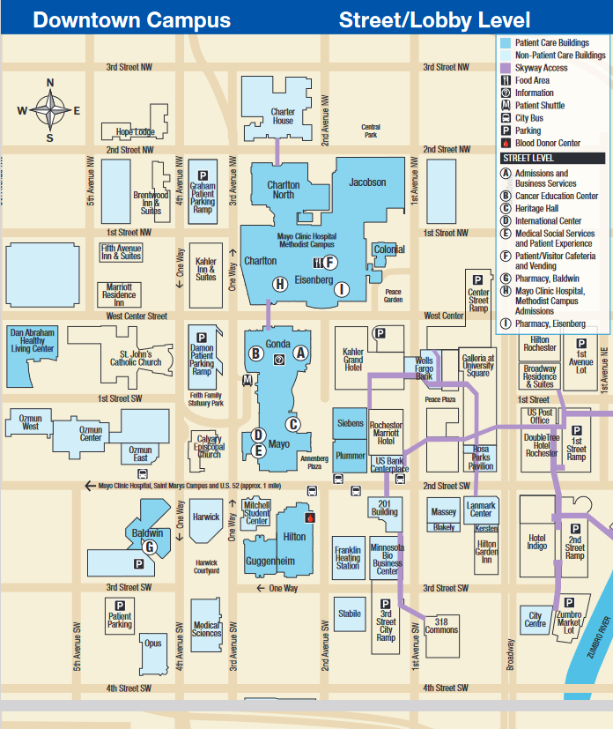
Campus Map
*
*Phillips Hall is within Siebens Building shown above.

Slide 13
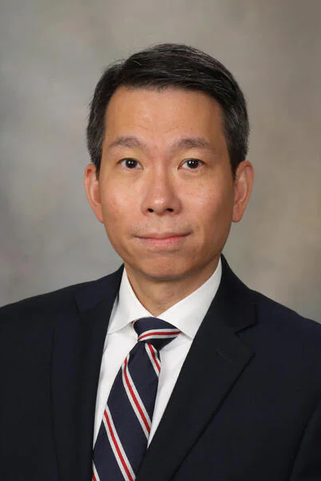
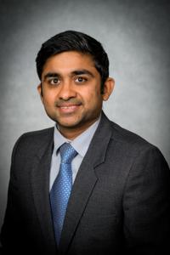
Thank You!
Our Fantastic Hosts
Mayo Clinic
For Your Attendance
See you next year!
Location and date to be announced soon
Ronald Go, MD Mayo Clinic
Gaurav Goyal, MD UAB
Notes:
Thank you slide for the end of each day

